Slide 1
Scenarios
## SCENARIO 0: R0 DO NOTHING (NO INTERVENTIONS: PROJECTION USING MODEL ESTIMATED PARAMETERS)
## SCENARIO 1: R0 DO NOTHING + SHIELD 65+
## SCENARIO 2: STAGE 3 SELF-ADAPTIVE Rt
## SCENARIO 3: STAGE 3 SELF-ADAPTIVE Rt + SHIELD 65+
## SCENARIO 4: CONTINUE TOTAL LOCKDOWN 1 MONTH LONGER
## SCENARIO 5: CONTINUE TOTAL LOCKDOWN 1 MONTH LONGER + SHIELD 65+
## SCENARIO 6: OBSERVED TREND
## SCENARIO 7: OBSERVED TREND Rt + SHIELD 65+

Slide 2
METHODS
For all scenarios in which at-risk populations are not shielded, we use the observed trend in the probabilities of severe illness for LAC – which decreased over time due to community self-adaptation.
We implement scenarios in which individuals 65+ are shielded, which comprise approximately 10% of the overall LAC population. In these scenarios we implement that the probabilities of severe illness are suddenly reduced as these populations are removed from the general population. This sudden reduction takes place on the same date that Stage 1 lockdown was implemented, since this is the time needed to understand we were facing a major public health crisis. We remove these individuals from the overall community by removing them from the susceptible population, then using the risk model to recalculate the population-average probabilities of severe illness without including these populations.
In the scenarios for which we assume Rt follows a community self-adapted decrease, we implement that the value of Rt would have gradually reduced from R0 to the observed Rt value in Stage 3 of ~1.5, beginning in mid-July. This involves a panel of public health restriction policies (notably including schools being closed), but not as stringent as the total community lock-down of Stage 1.

Slide 3
Analysis of scenarios
@Dave: In figures from last night I had been removing individuals with 65+ and/or any comorbidities. Then I calculated that 65+ and/or comorbidities was almost 50% of the population (too many to shield) (and, I had not been removing 50% from of the susceptible population). So I repeated the analysis with 65+ only and results are around the same as last night, with slightly more deaths and more hospitalizations. So I think we should definitely present only scenario with 65+ since that is a more plausible scenario to remove!
Shielding 65+, no matter what is done to R(t), prevents a lot of deaths. Even if combined with Trump scenario of do absolutely nothing to decrease R0 (i.e. R(t) always = 4), shielding 65+ populations results in almost exactly the same total number of deaths as observed, as herd immunity is reached. However in this scenario, the numbers in hospital would have greatly surpassed capacity.
The Sweden scenario of community self-adaptive Rt that goes down to 1.5 by end of April results in slightly more deaths overall but greatly exceeds healthcare capacity. But combined with shielding 65+, this reduces overall number of deaths by around 1/3. This strategy is not recommended, however, as it still leads to substantially overwhelming healthcare facilities.
Interestingly, extending total lockdown by 1 month makes very little difference to observed deaths and hospitalizations. But extending total lockdown by 1 month + shielding 65+ makes a huge impact to reducing deaths – averting ~90% of observed deaths.
However keeping the observed course in terms of restrictions in contact for the general community without extending total lockdown by 1 month (i.e., Rt is what was observed for LAC), but shielding those 65+, could have had a very similar effect, averting ~80% of observed deaths.
Main conclusion: the early stay at home saved many lives because it both reduced transmission and protected the elderly. A more relaxed initial lockdown but more strict protection of at-risk could have also averted many deaths, however at the expense of exceeding healthcare capacity, thus likely leading to more severe illnesses and deaths not accounted for by this model. Thus the main takeaway is that strict initial restrictions to society were key, and that it is ok to relax these so long as the outbreak continues to remain more prevalent in younger less at-risk populations and older and other vulnerable populations are shielded. In anticipation of an upcoming increase in cases this fall, it will be important to ramp up efforts to protect the elderly and vulnerable populations.

Slide 4
Discussion
@Dave: Does this point get noted in Results or in Discussion? Main conclusion: the early stay at home saved many lives because it both reduced transmission and protected the elderly. A more relaxed initial lockdown but more strict protection of at-risk could have also averted many deaths, however at the expense of exceeding healthcare capacity, thus likely leading to more severe illnesses and deaths not accounted for by this model. Thus the main takeaway is that strict initial restrictions to society were key, and that it is ok to relax these so long as the outbreak continues to remain more prevalent in younger less at-risk populations and older and other vulnerable populations are shielded. In anticipation of an upcoming increase in cases this fall, it will be important to ramp up efforts to protect the 65+ and vulnerable populations.
Generalizability: We do this analysis for LAC. This analysis could be generalized to different regions, which will have different percentages of at-risk individuals, to understand the combined impact of community + specific subpopulation interventions based on the region-specific distribution of vulnerable populations in each subpopulation.
Limitations: It is important to note that in the scenarios in which the 65+ population is shielded, we implement this by operating only on numbers of infection, hospitalizations and deaths. We do not account for the health impact of COVID that do not require hospitalization, including long term effects. We also do not account for critical illnesses or deaths that could result from healthcare capacity being exceeded.

Slide 5
TO DO + QUESTIONS
Show R(t) for each scenario (in 1 plot)
Show Alpha/Kappa/Delta(t) for each scenario in 1 plot?? Maybe just the composite calculated P(D|I)?
Which compartments to show trends for in paper? I have questions here because it is interesting to see the comparisons with observed data, but it is also interesting to see the current in compartment, esp. for hospitalizations and illnesses.
Maybe:
New Infections (vs. data), Current Infections
New Hospitalizations (vs. data), Current infections
Cumulative Deaths (vs. data)

Slide 6
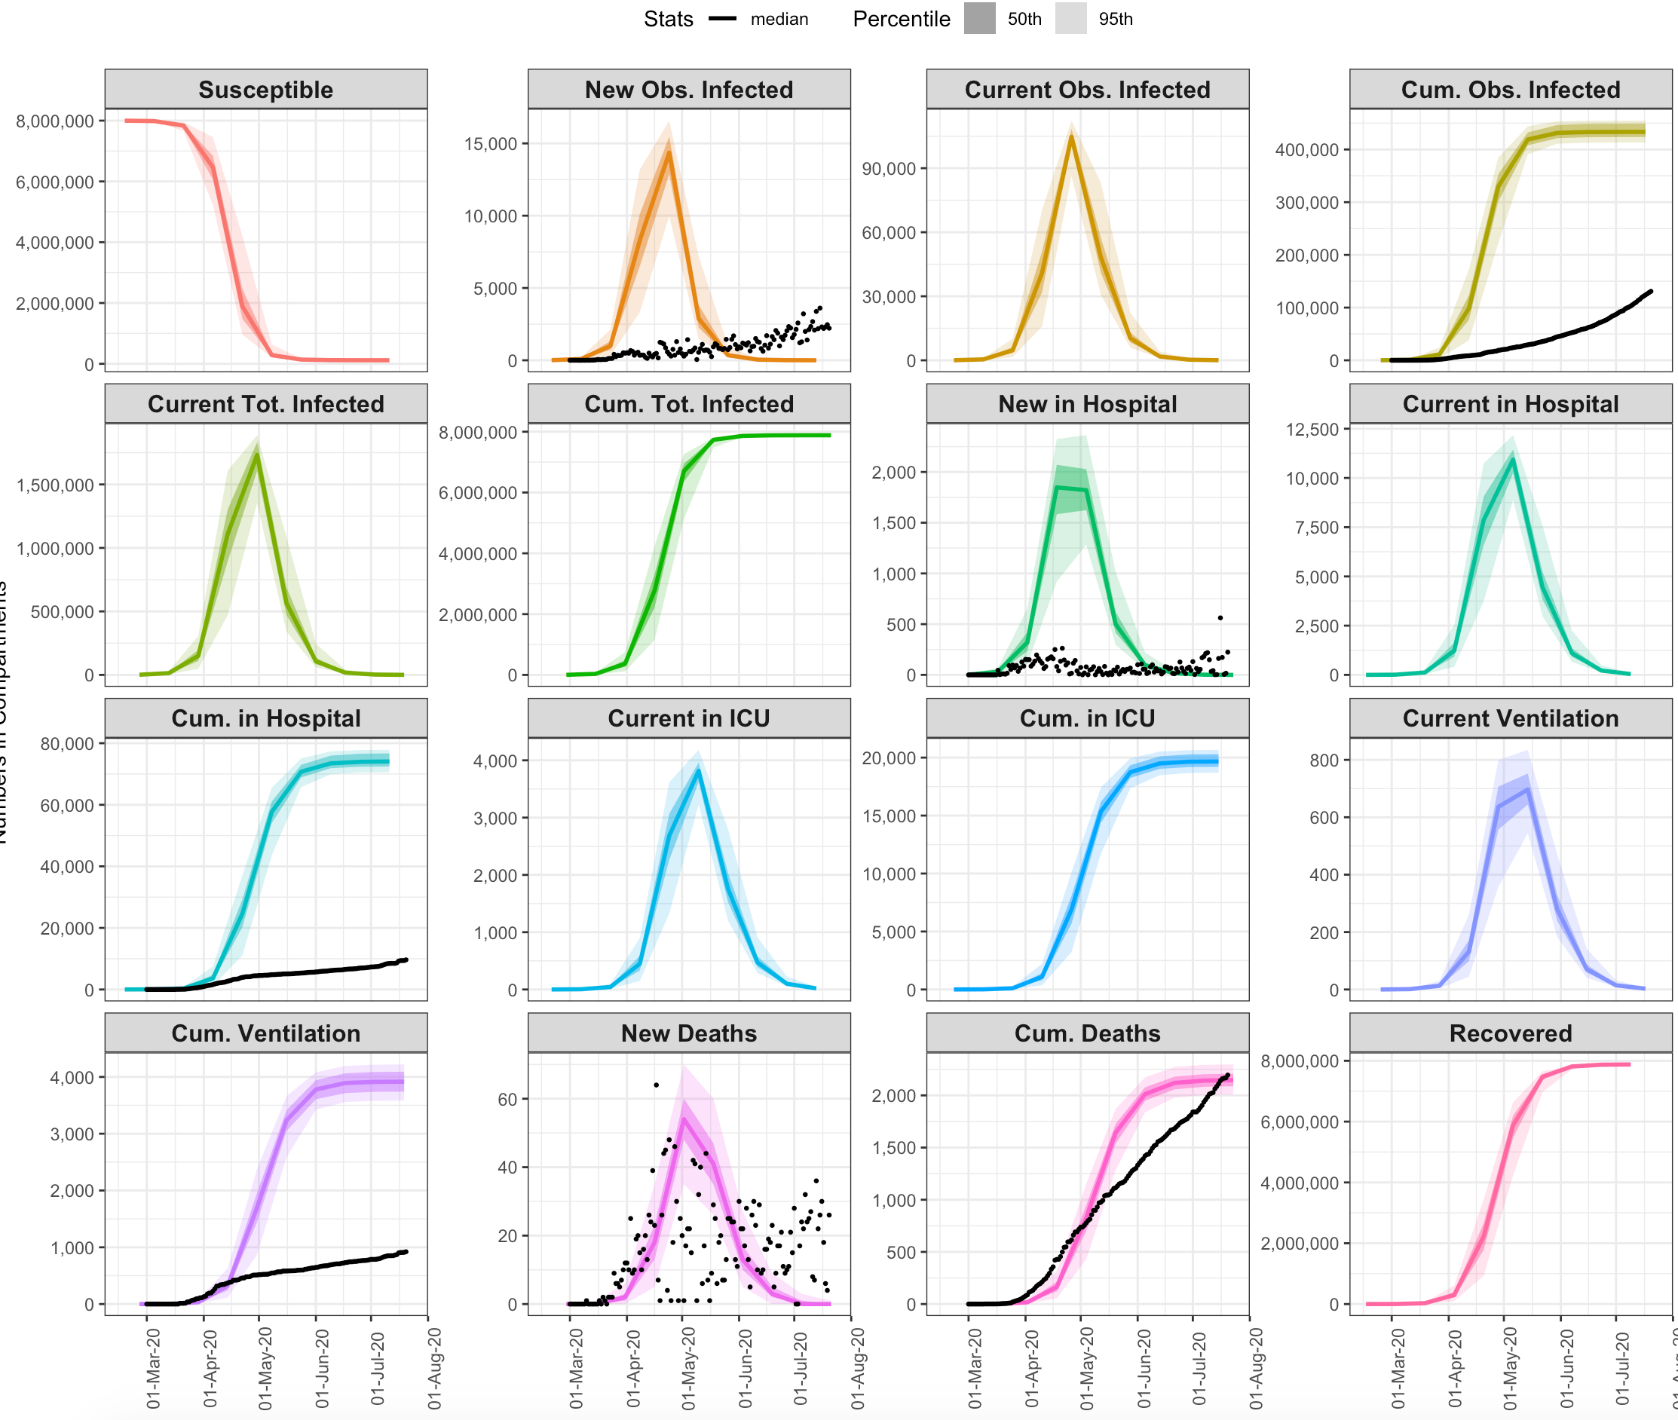
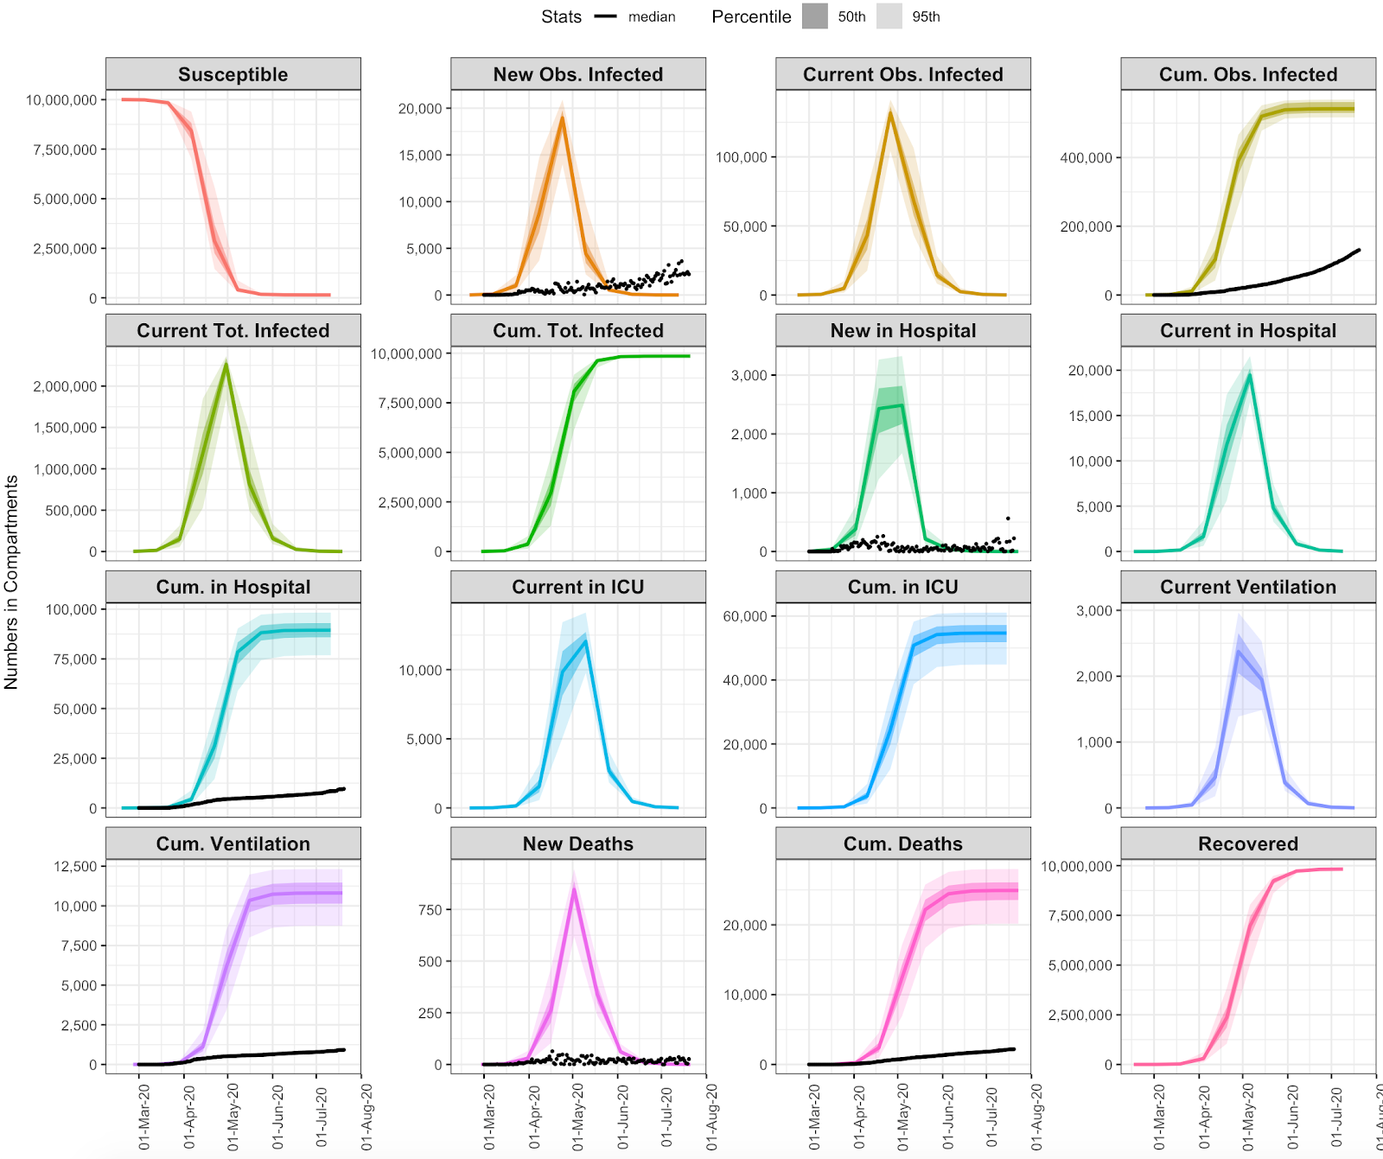
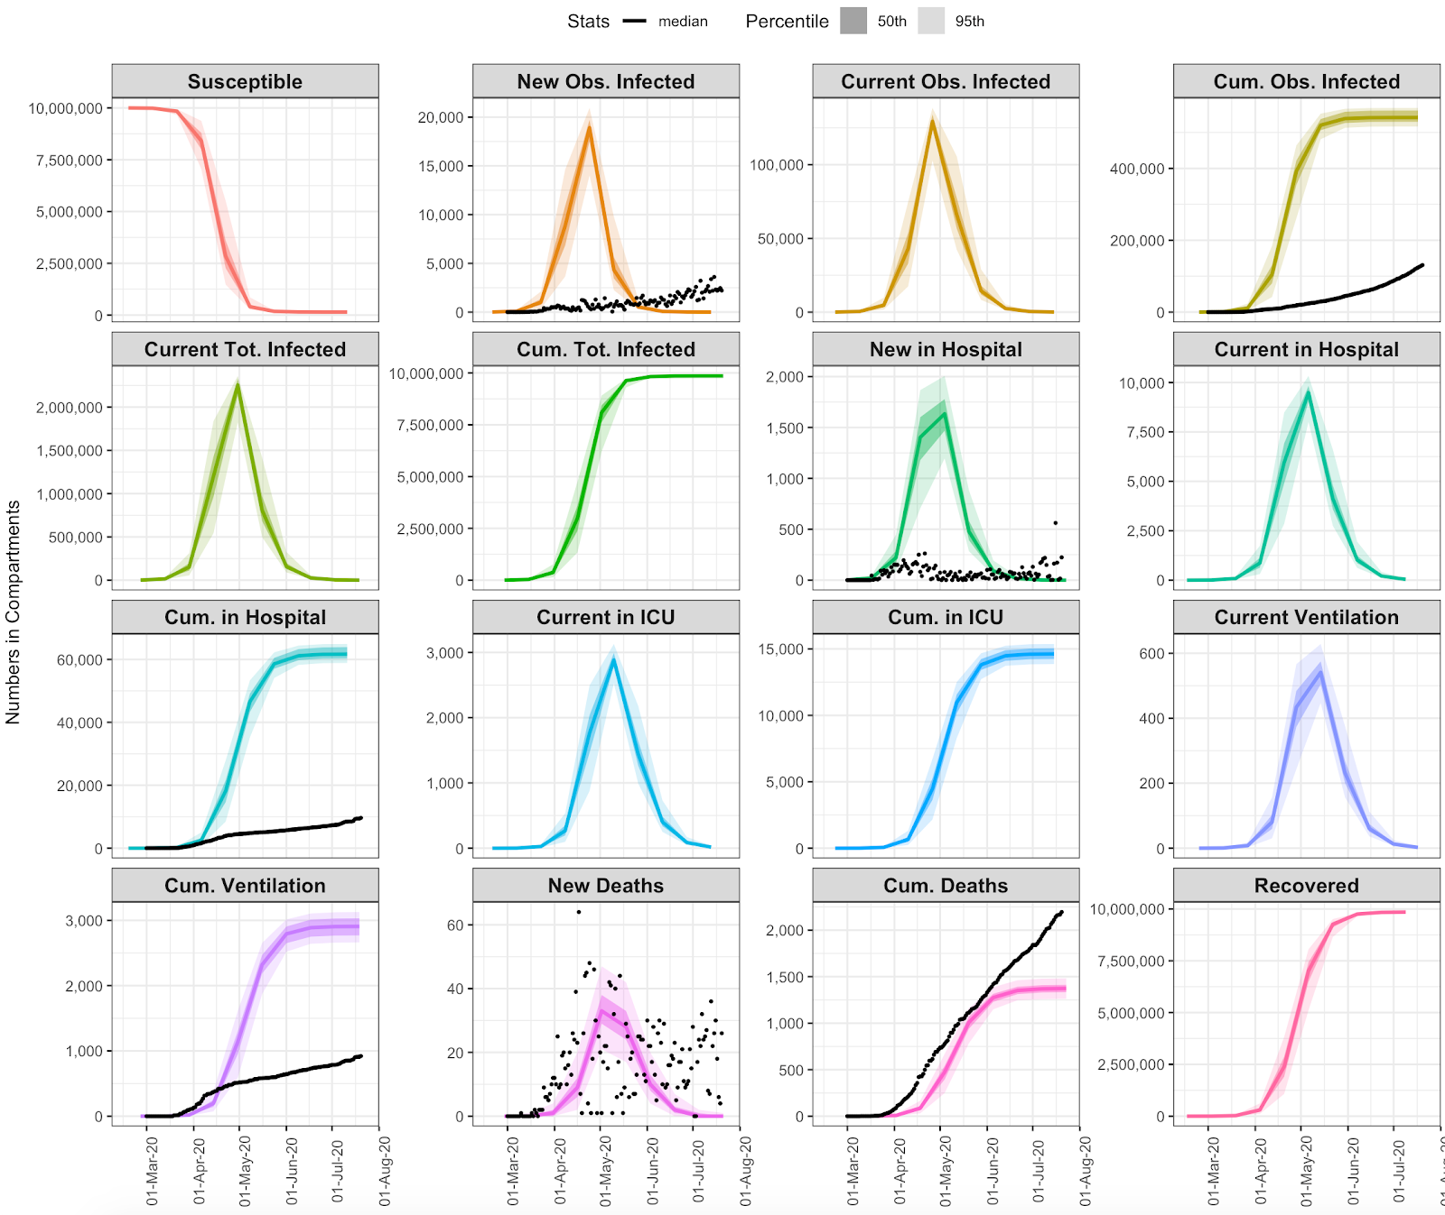
## SCENARIO 0: R0 DO NOTHING
(Trump Scenario)
## SCENARIO 1: R0 DO NOTHING + SHIELD SPECIFIC POPULATIONS

Slide 7
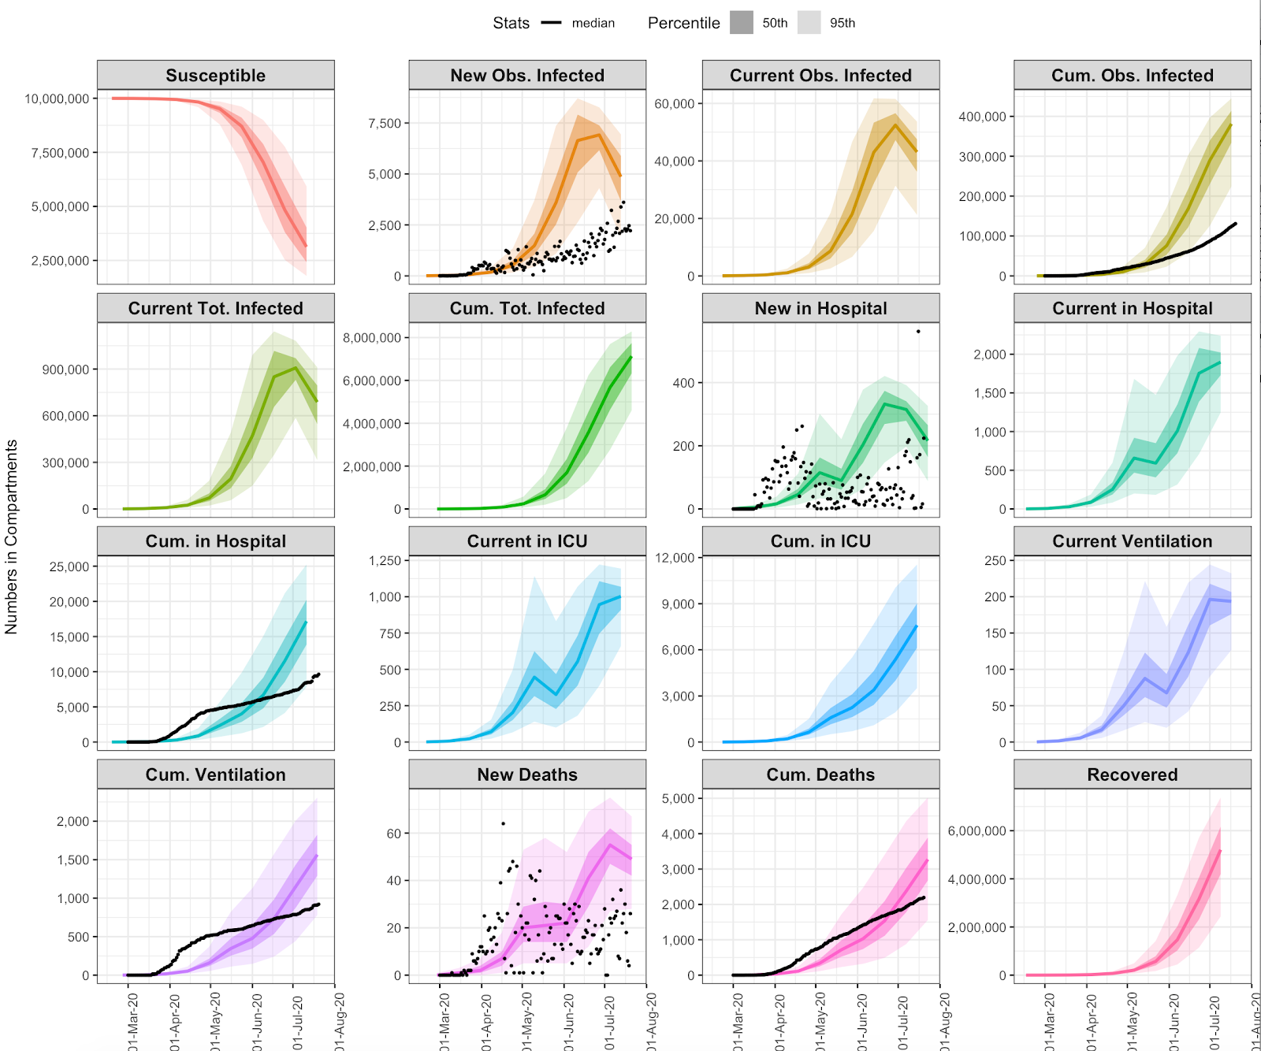
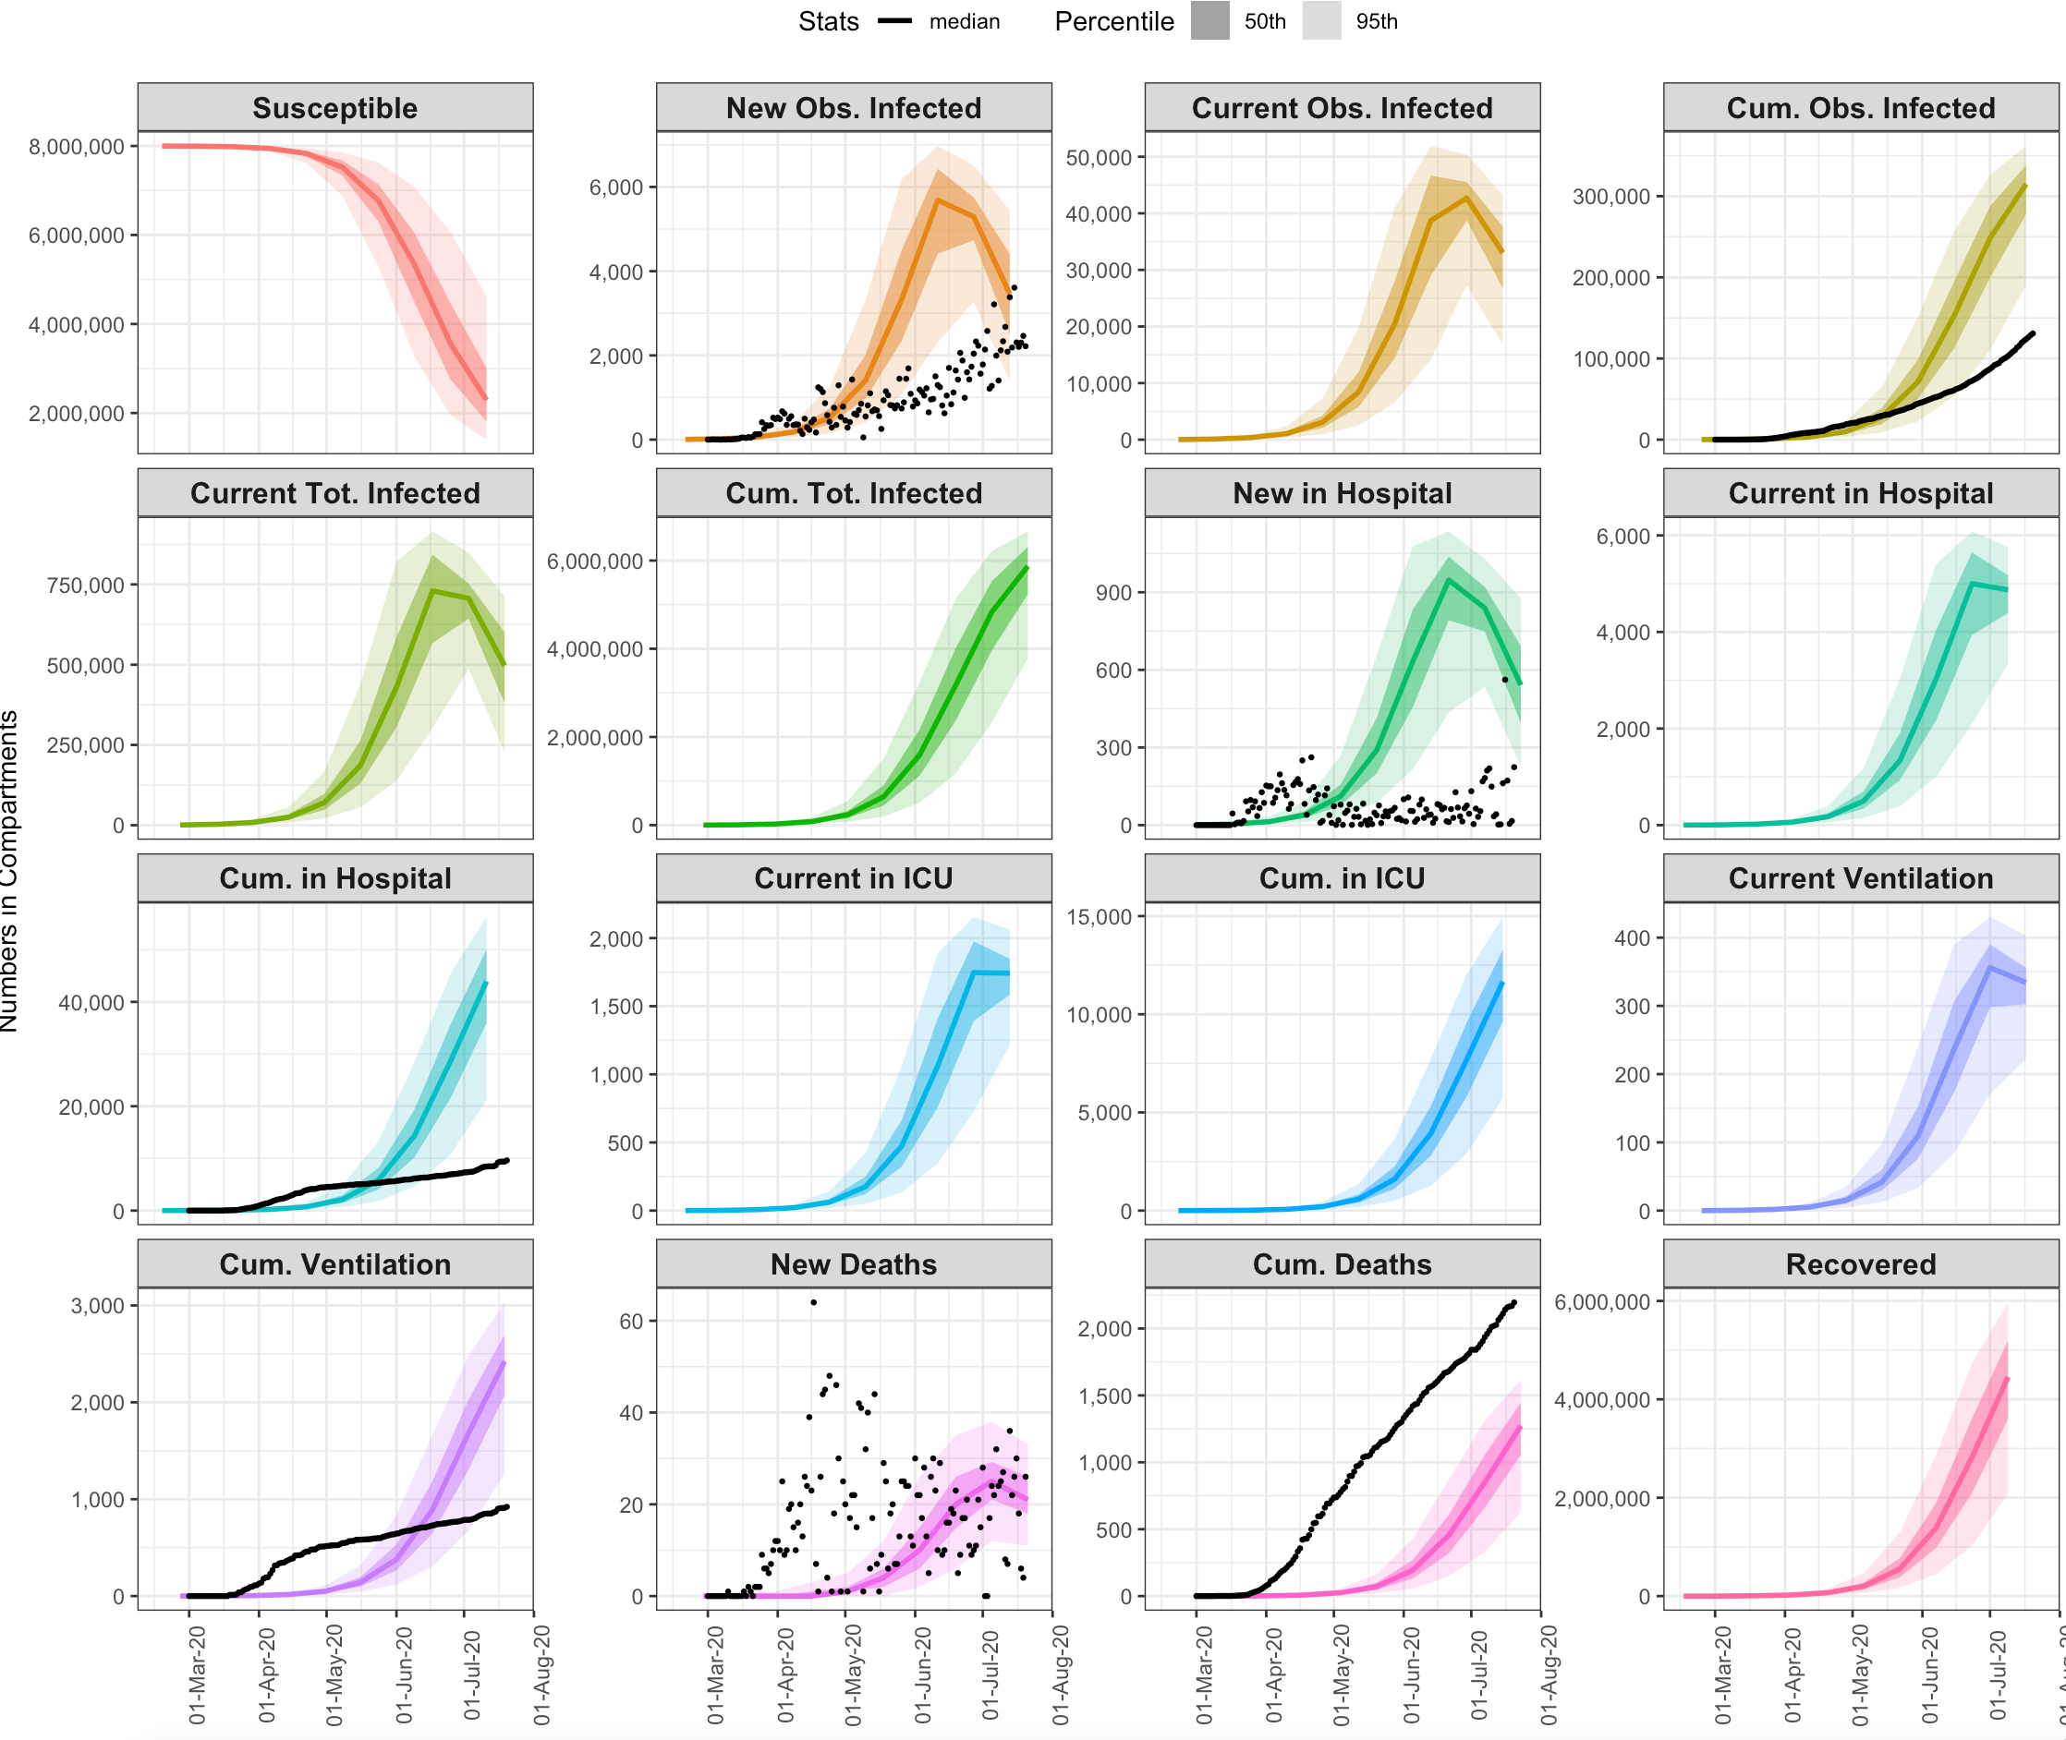
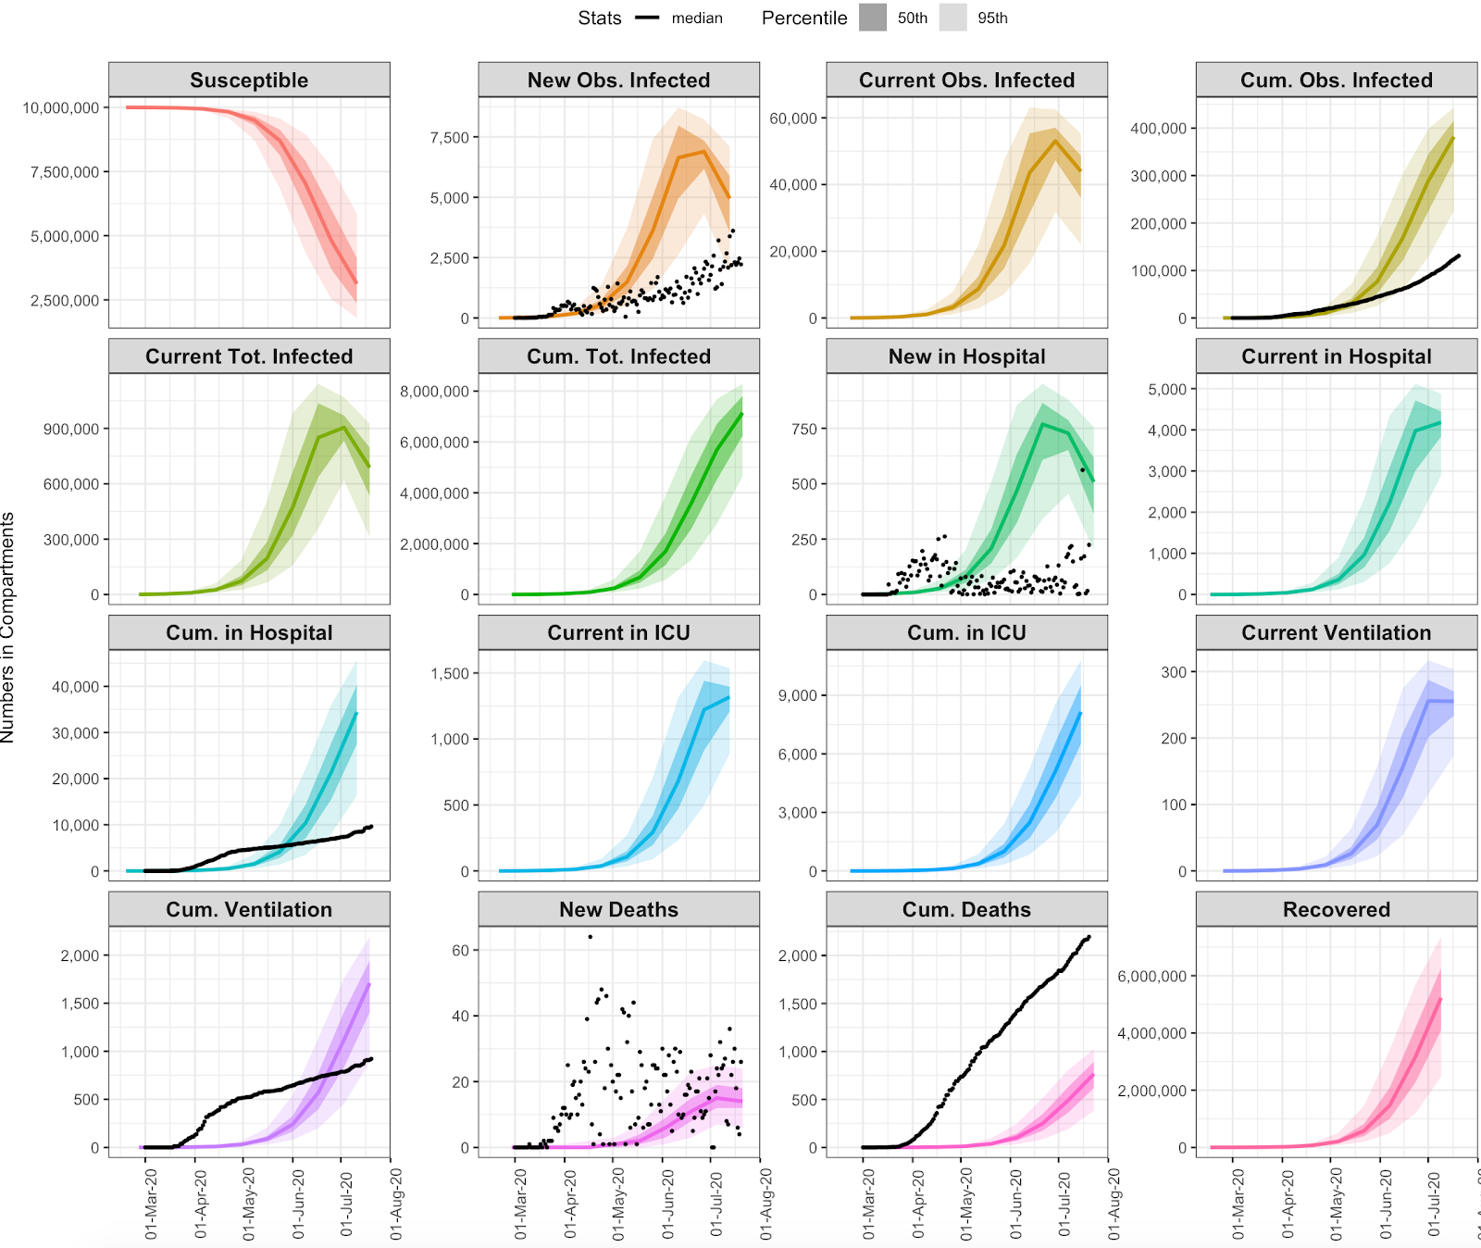
## SCENARIO 2: STAGE 3 SELF-ADAPTIVE Rt (go almost immediately into Stage 3)
## SCENARIO 3: STAGE 3 SELF-ADAPTIVE Rt + SHIELD SPECIFIC POPULATIONS (this is what I would call Sweden Scenario)

Slide 8
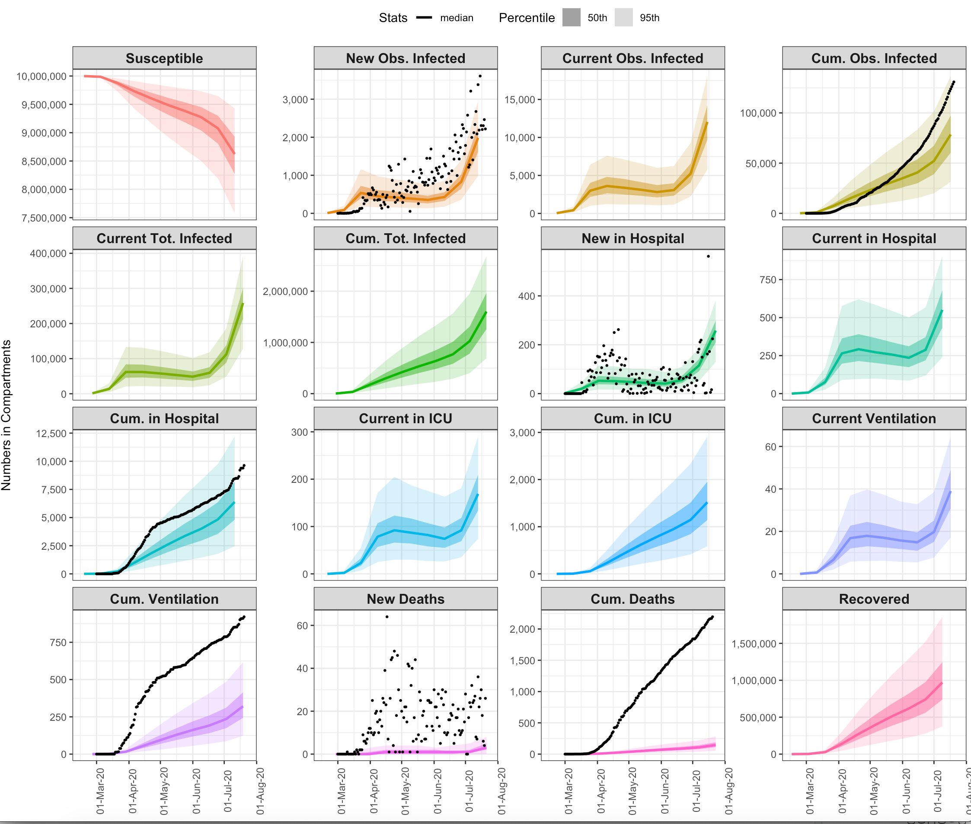
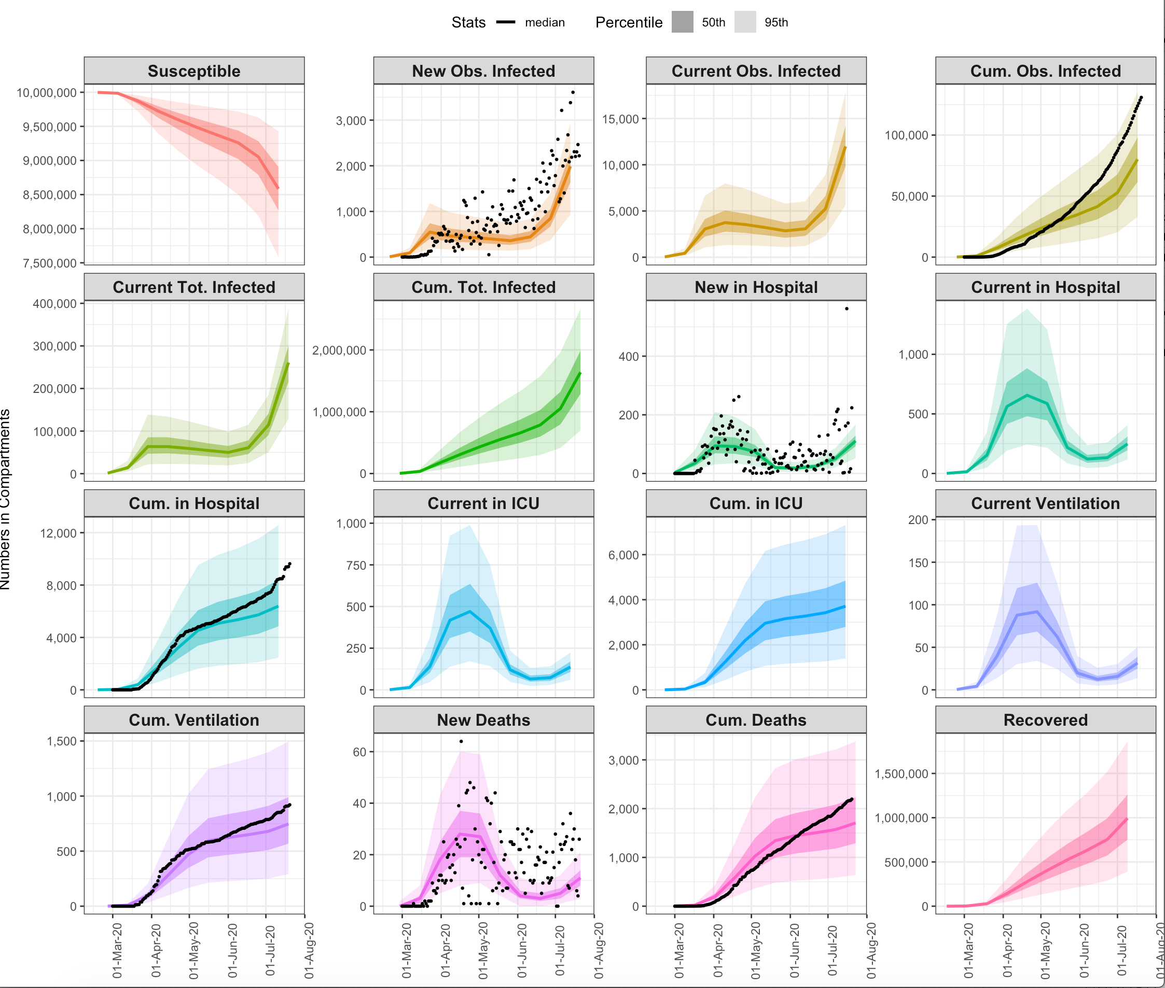
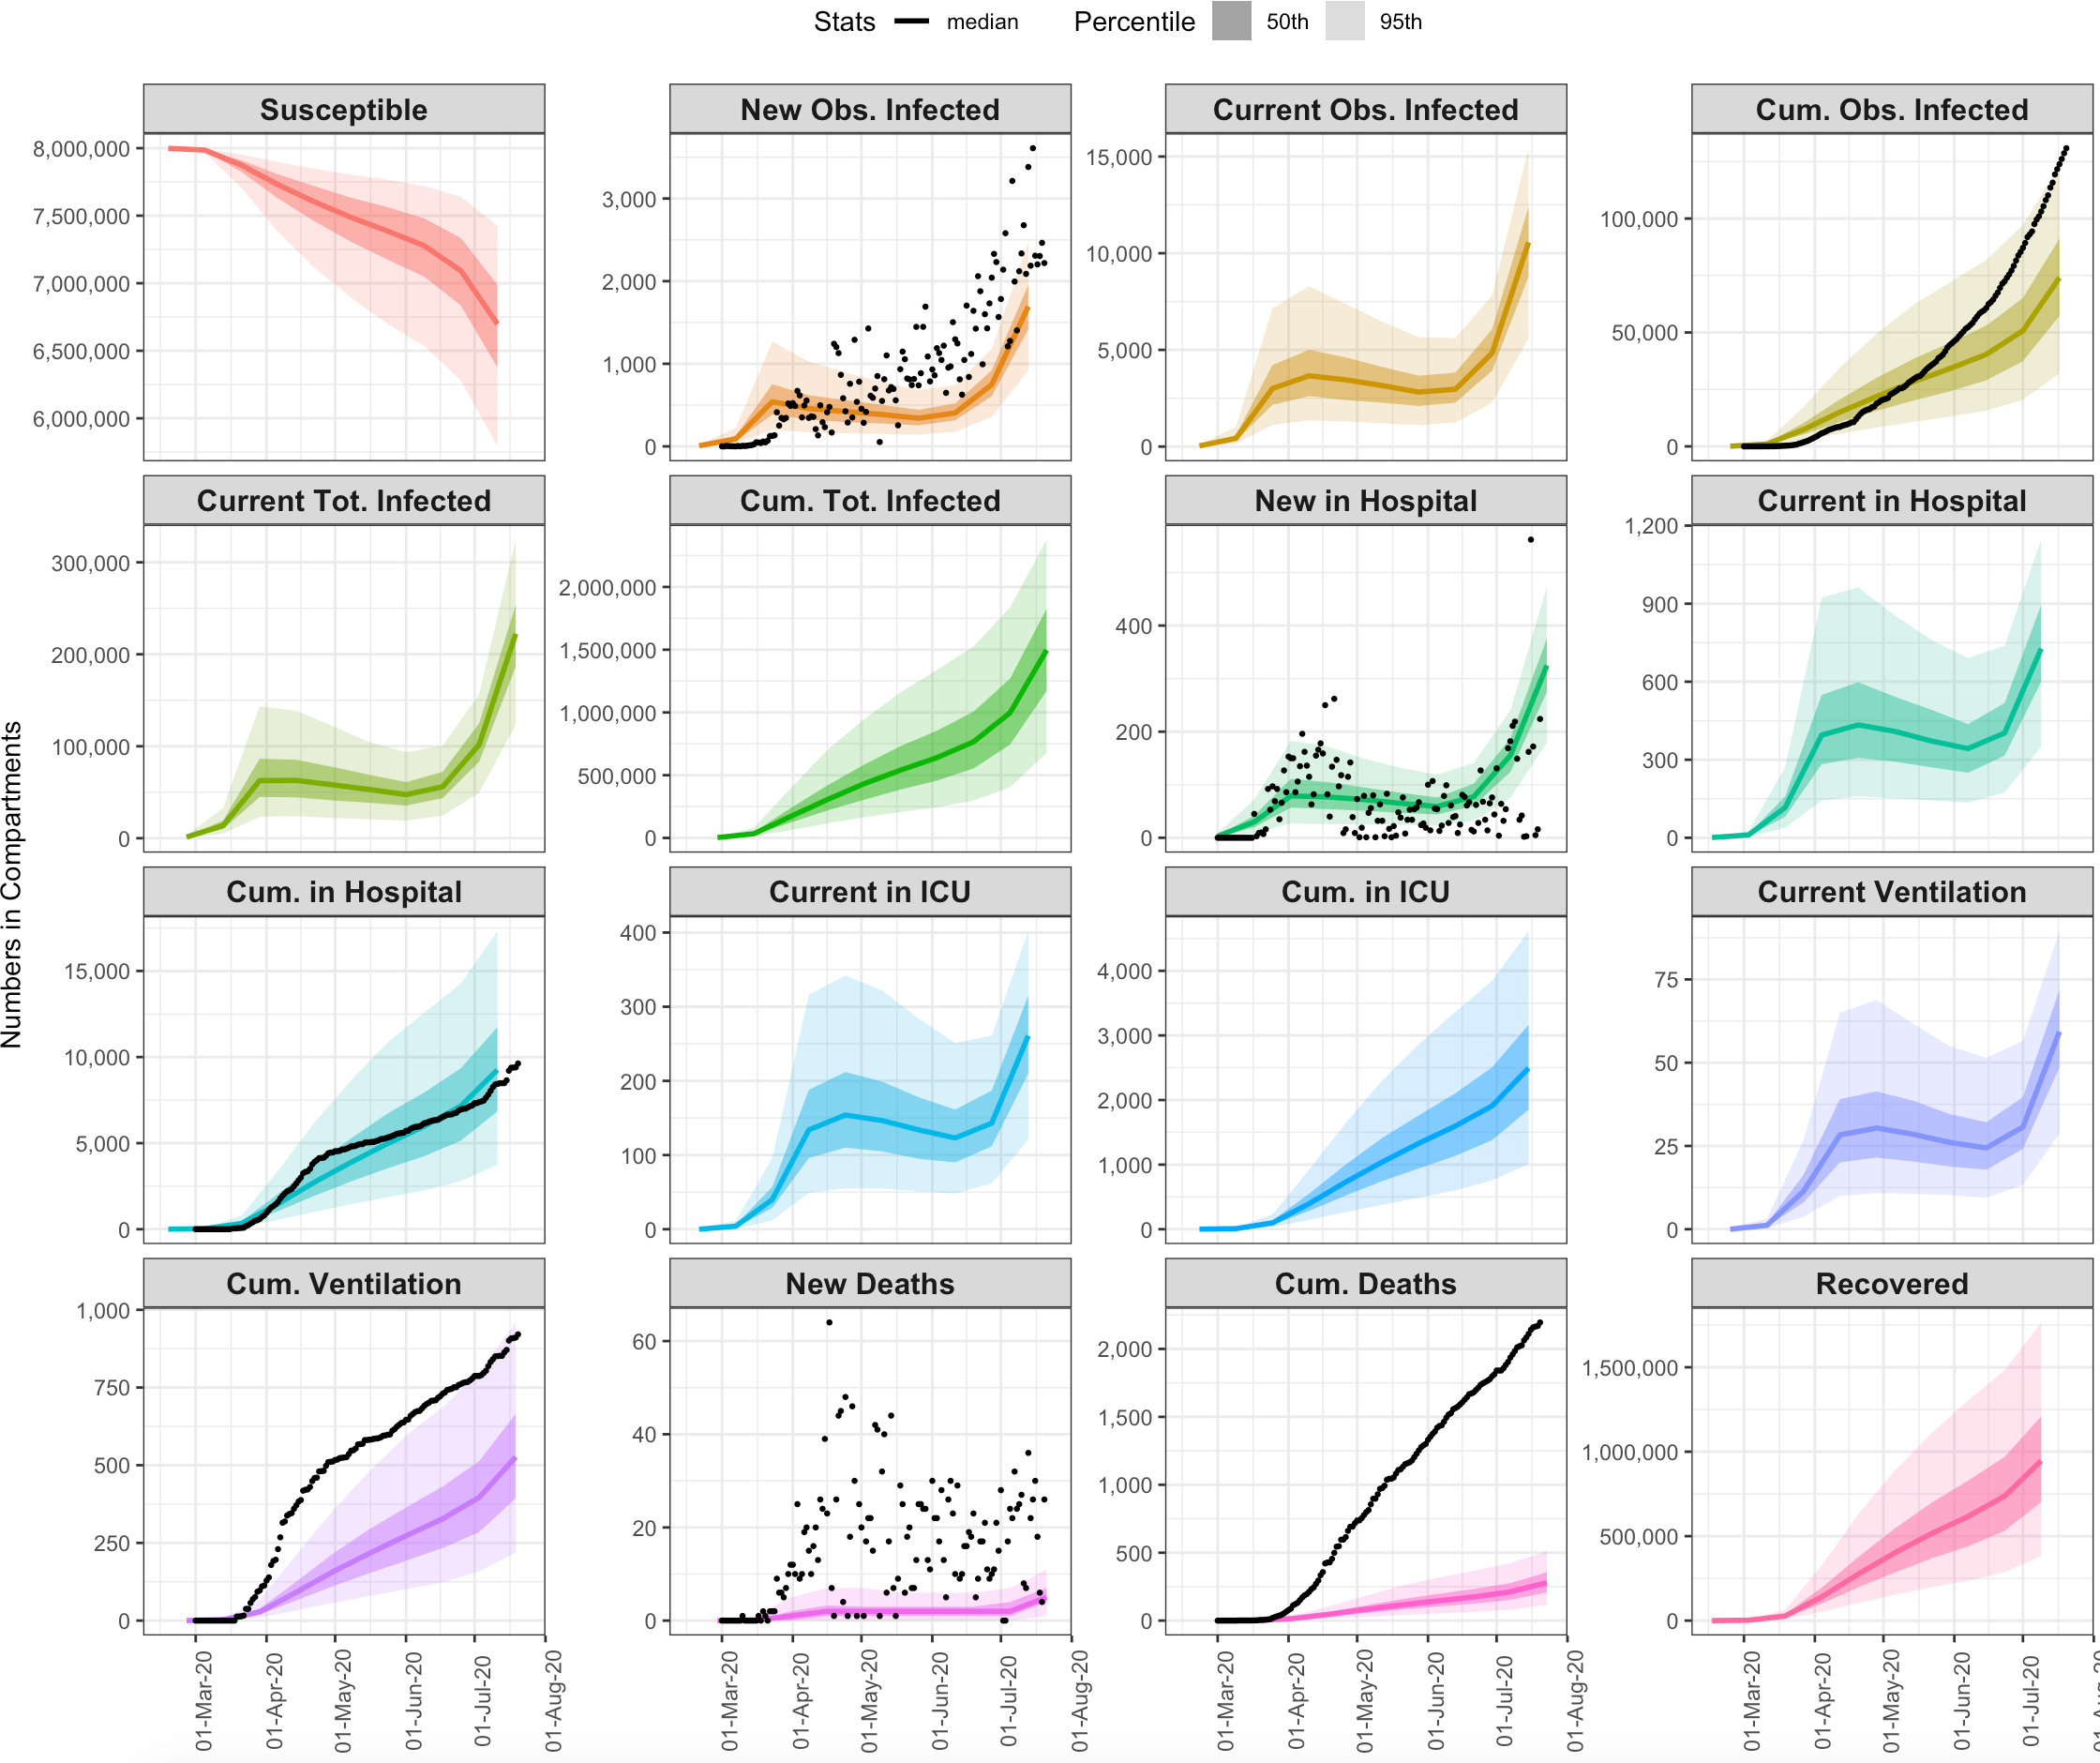
## SCENARIO 4: CONTINUE TOTAL LOCKDOWN 1 MONTH LONGER
## SCENARIO 5: CONTINUE TOTAL LOCKDOWN 1 MONTH LONGER + SHIELD SPECIFIC POPULATIONS

Slide 9
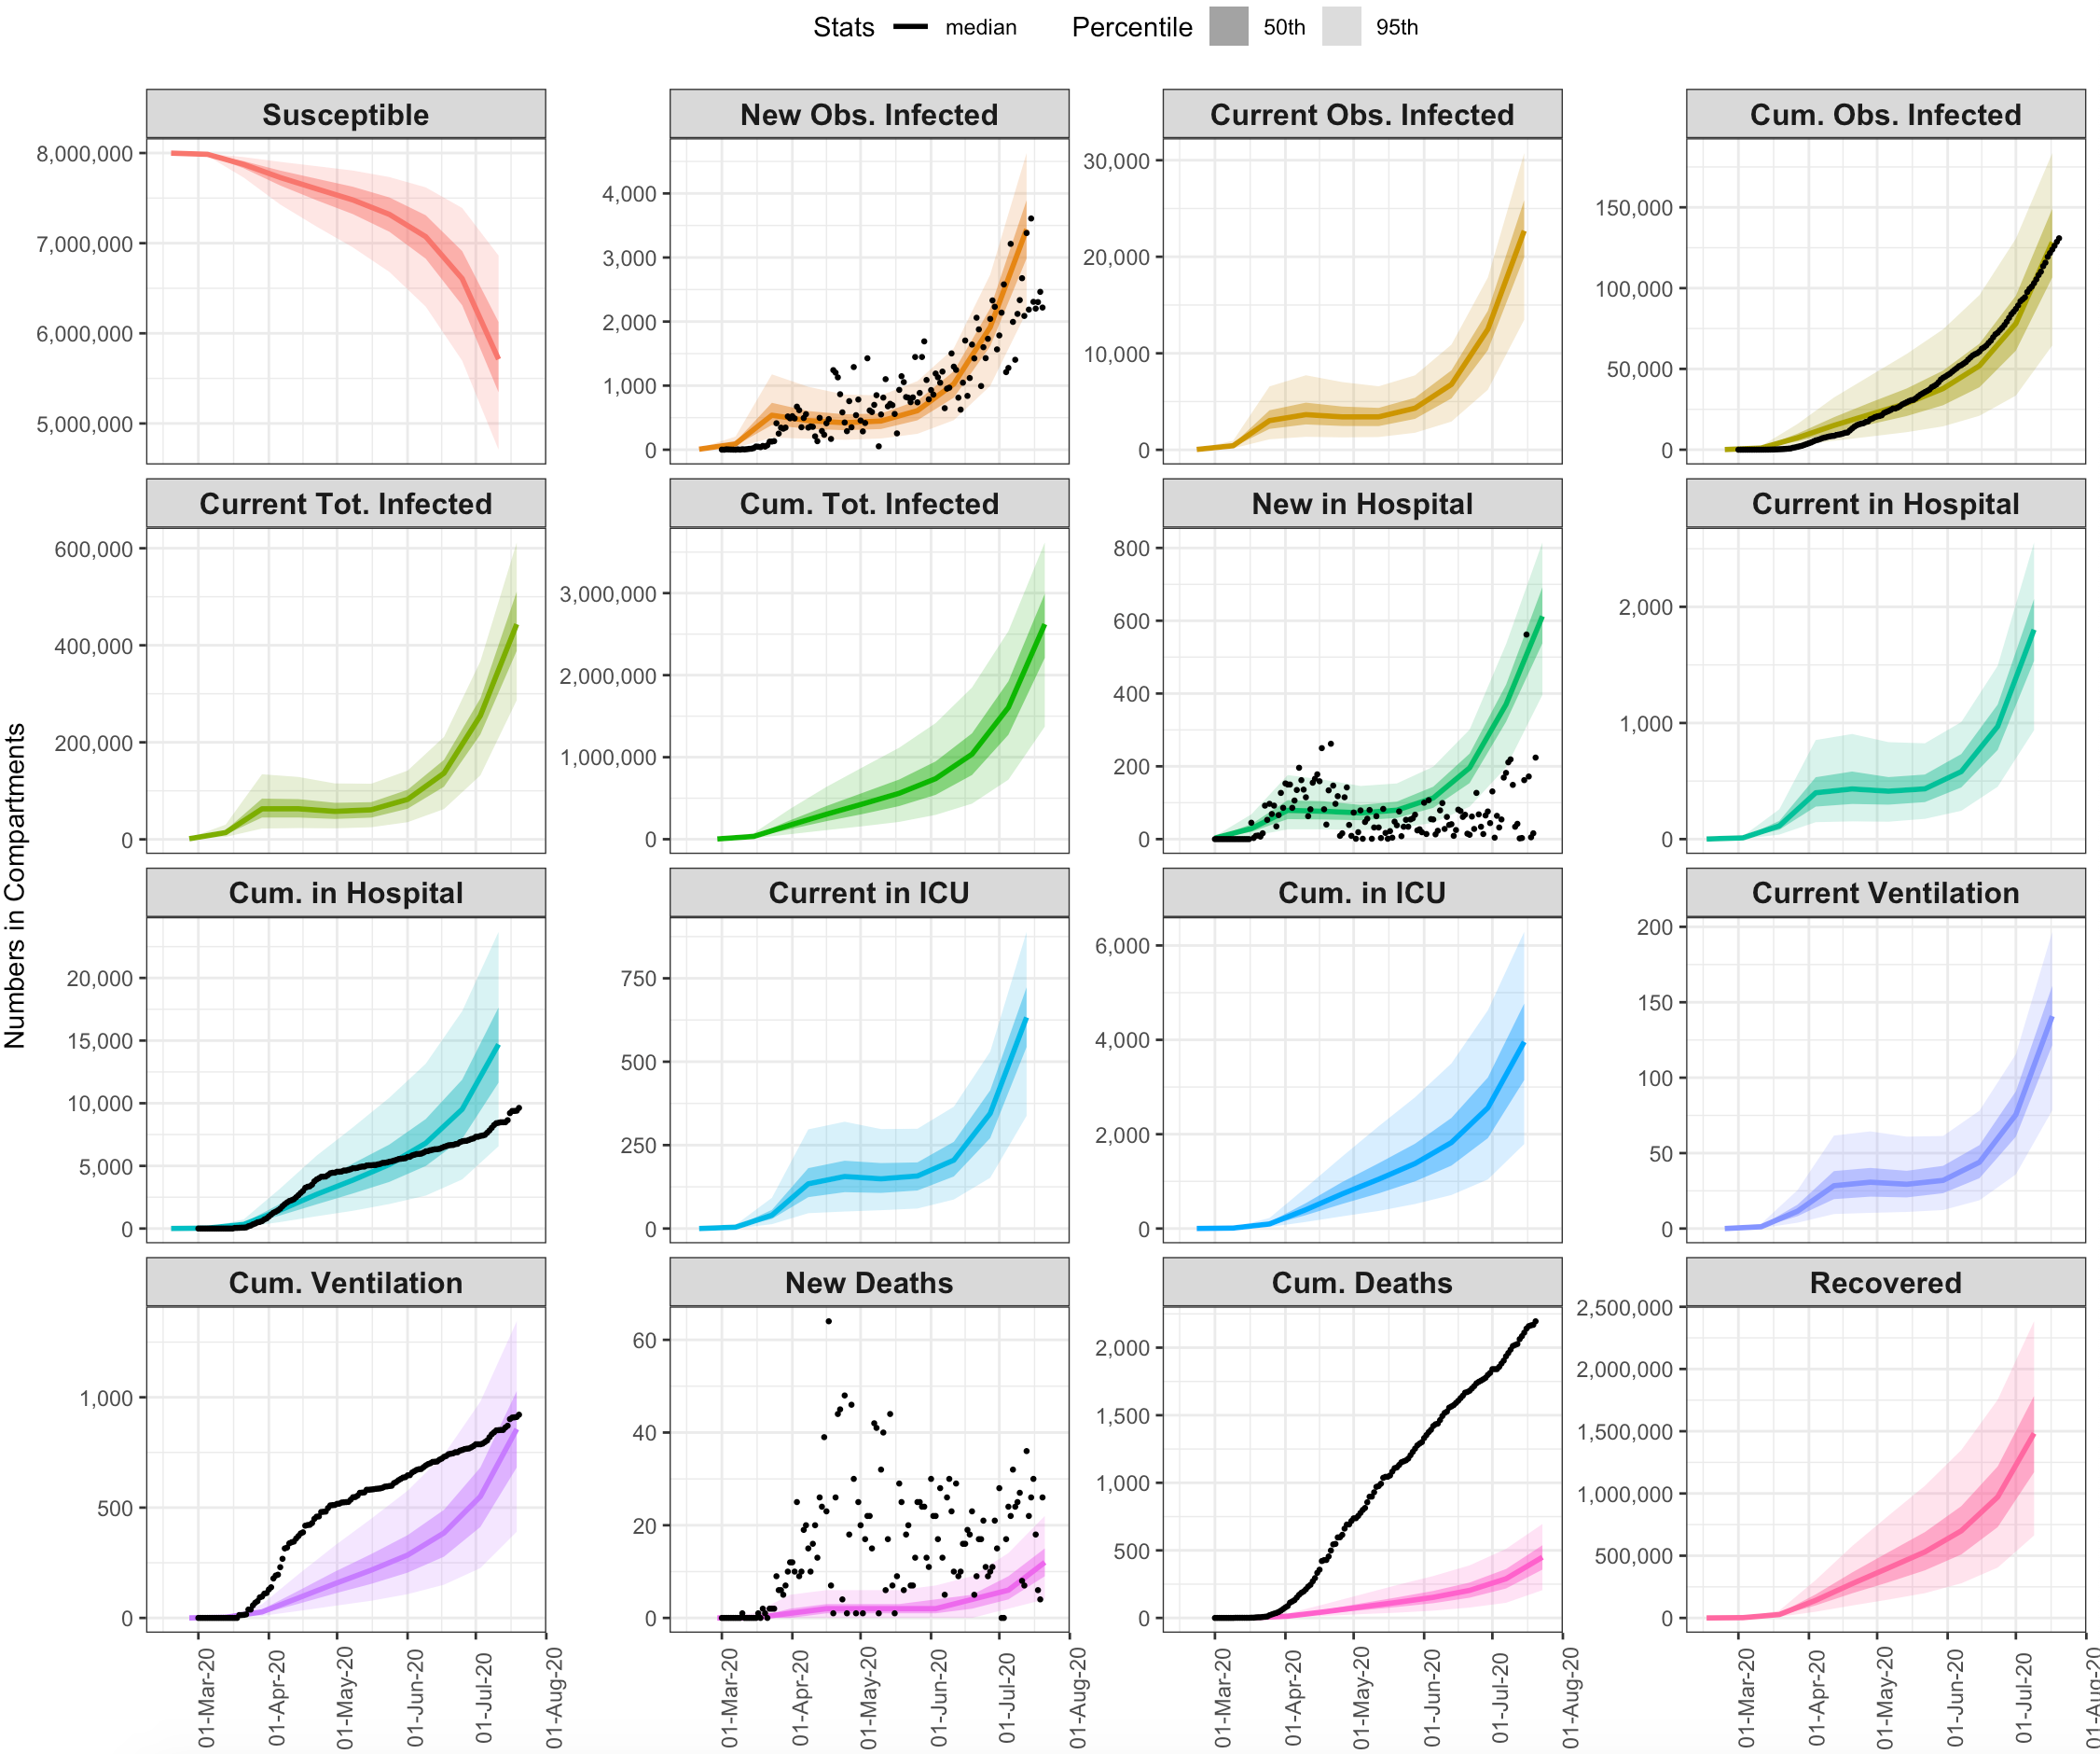
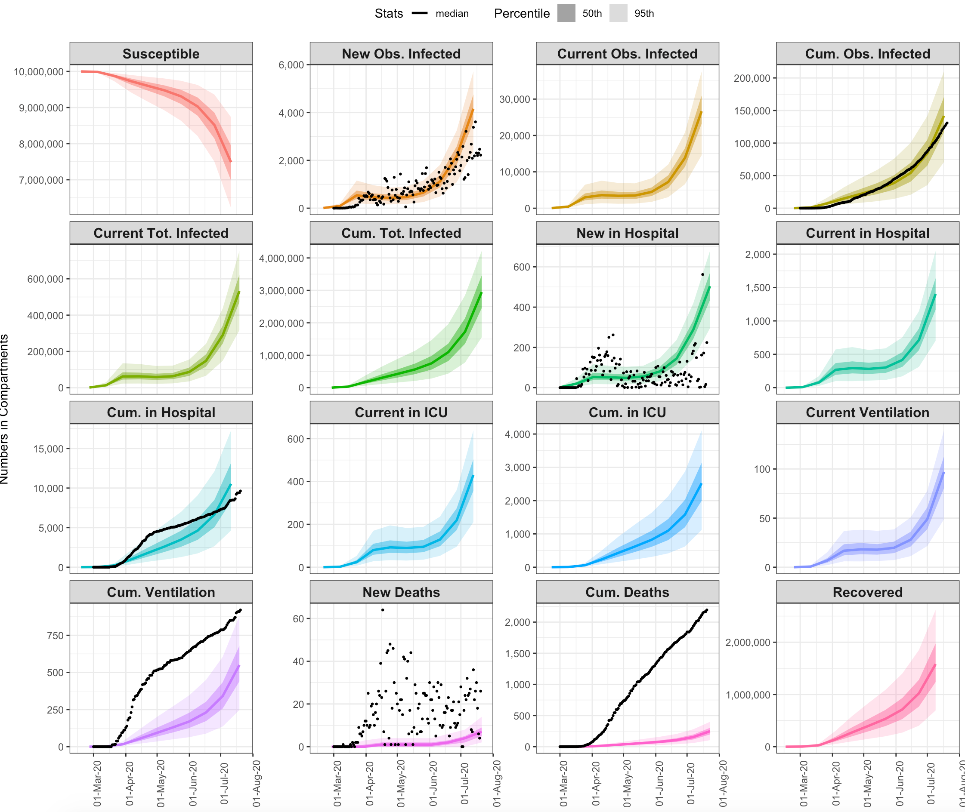
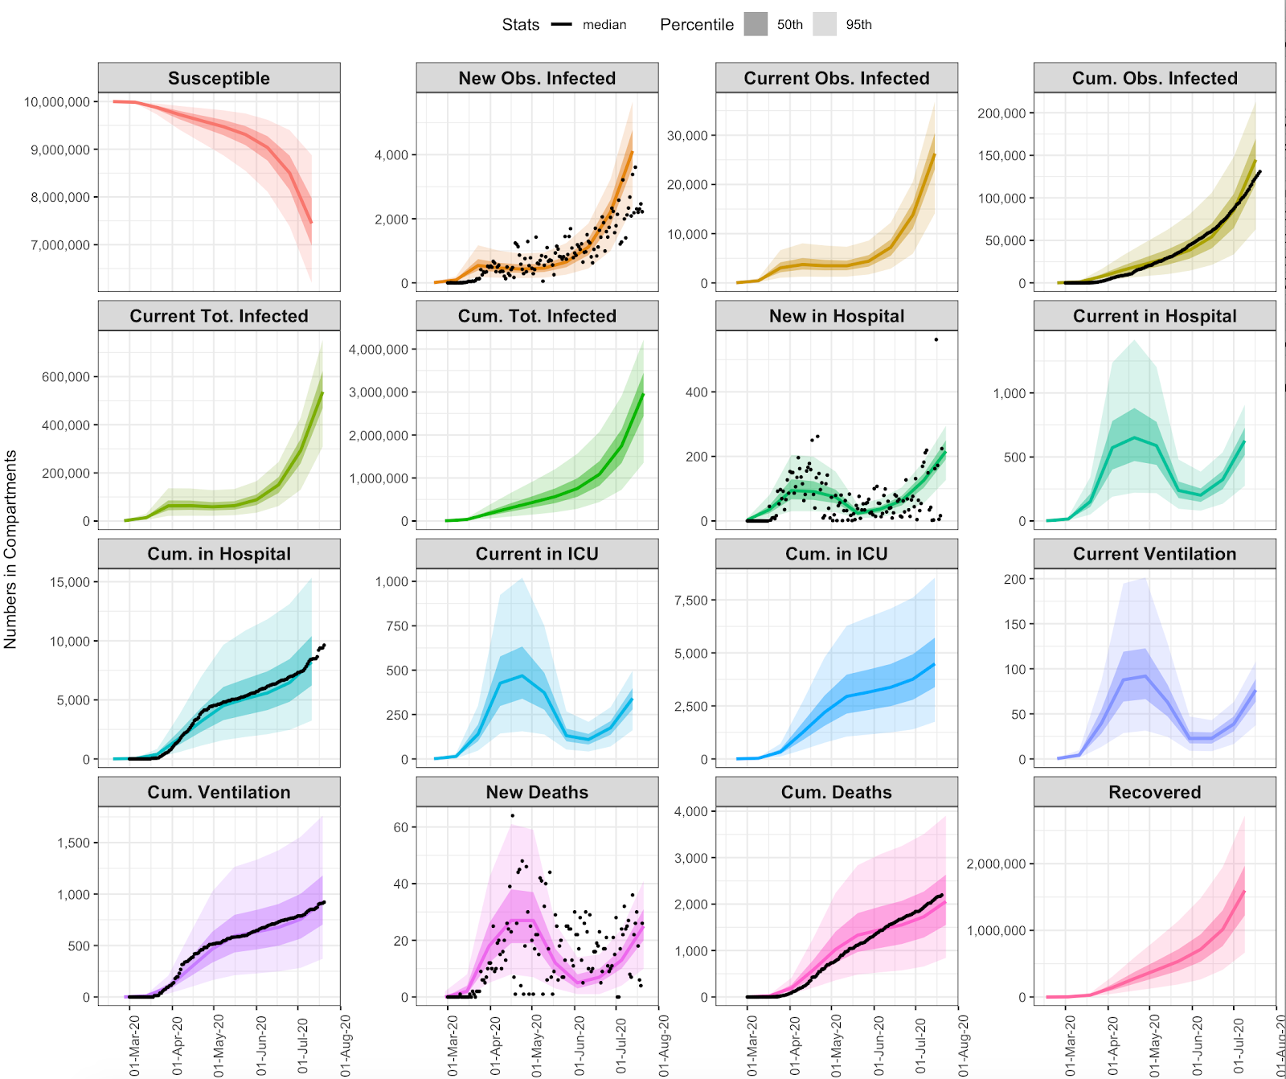
## SCENARIO 6: OBSERVED TREND Rt
## SCENARIO 7: OBSERVED TREND Rt + SHIELD SPECIFIC POPULATIONS

